Slide 1

Edge Computing in Healthcare
Sabyasachi Mukhopadhyay
Google Developer Expert in Machine Learning
Kolkata Lead, Facebook Developer Circle
Intel Software Innovator
Assistant Professor, BIMS Kolkata (Affiliated to MAKAUT)
Visiting Faculty, SCIT Pune (Deemed University)
Ambassador & Co-Organizer, ODSC Kolkata Chapter

Slide 2
AGENDA
CURRENT HYPE
CLOUD IOT LIMITATIONS
WHAT IS EDGE IOT ?
GOOD FIT FOR IIOT
EDGE USE CASES
POSSIBLE SOLUTIONS FOR IMPLEMENTATION
2

Slide 3
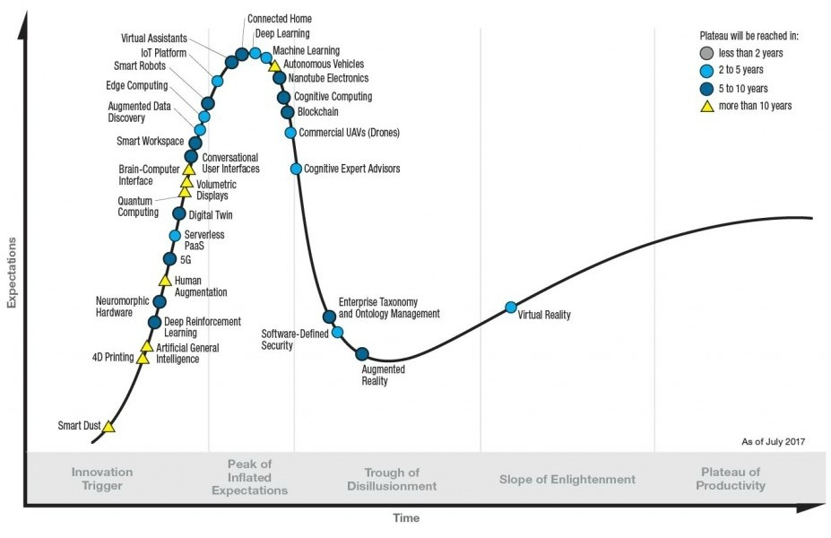

Current HYPE
3

Slide 4
CLOUD IOT LIMITATIONS : SMART CITY EXAMPLE

Slide 5




Number of Sensors
MILLIONS OF NODES
Smart City
Smart Factory
Smart Building
Size of Infrastructure
5

Slide 6









LEGACY NETWORKS
X.25 (Low Speed)
GPRS (Low Speed)
Ethernet (High Speed)
6

Slide 7




WHAT IOT REALLY MEANS
Bandwidth
Number of street lights: ~250,000
Number of traffic signals: ~50,000
Real-time processing
Machine learning
10 kB/s per sensor = 30 GB/s
Smart traffic light
7

Slide 8
EDGE COMPUTING ?

Slide 9
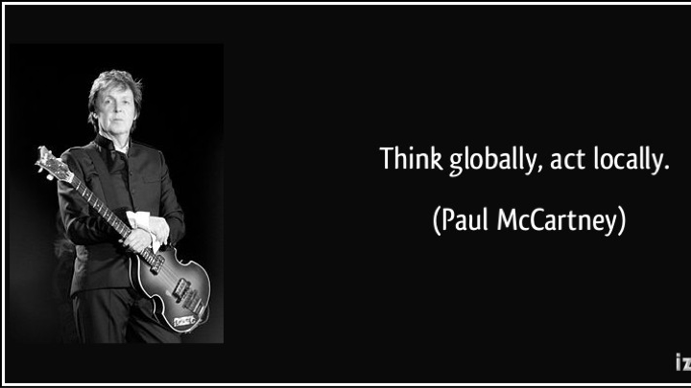
10

Slide 10
VALUE OF DATA IN TIME
VALUE
ACT/ REACT
UNDERSTAND/PLAN
TIME
10

Slide 11
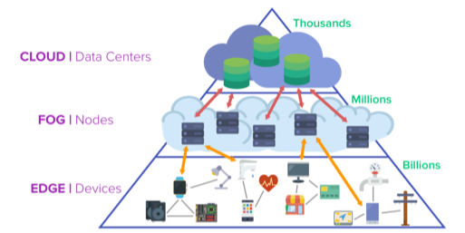
CLOUD / FOG / EDGE
SOURCES SUPINFO
11

Slide 12
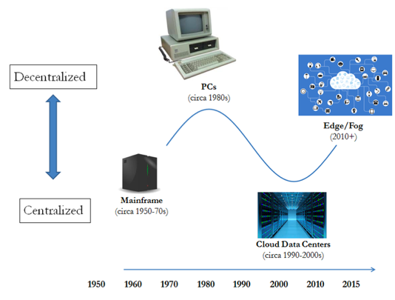
AN INFINITE CYCLE

Slide 13
WHEN EDGE CAN BE THE SOLUTION
REAL TIME CONSTRAINT
INTERMITTENT NETWORK
NEED FOR LOCAL PROCESSING
BANDWITH CONSTRAINT
MAKING BIG DATA SMALLER
STRONG CYBER-SECURITY CONSTRAINT

Slide 14
ON-PREMISE VERSUS EDGE
DEVICE MANAGEMENT LIFECYCLE
SOFTWARE ABSTRACTION THANKS TO INTELLIGENT
AGENTS
HUGE COMPUTING CAPABILITIES THANKS TO DISTRIBUTED ARCHITECTURE + CLOUD

Slide 15
DOWNSIDE OF EDGE
ADDITIONAL DIRECT COST / DEVICE
HW FOOTPRINT OF AGENTS
MORE SOFTWARE = MORE BUGS

Slide 16
IIOT : THE RIGHT FIT FOR EDGE

Slide 17
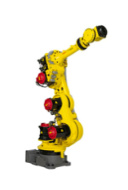

TIMING IS KEY
HTTP DELAY = 1s
1s = 30 ROTATION

Slide 18
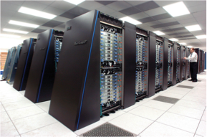

EMBEDDED DEVICES BECOMING SUPERPOWERFUL
=

Slide 19
SOME USE CASES

Slide 20
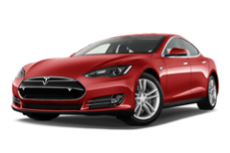

CAR IS A SUPER COMPUTER
Business case
Device plugged to the CAN and ODB buses.
Live Capture of all electric signals from the car.
Use of exogenous data (weather, driver’s behaviors…).
Objective
Predict a battery failure live (while driving).
Organize maintenance operations directly with the garage.
Then expand the business case to other possible failures.
Result
Live prediction of battery failure.
Automatic alert to be transmitted to the garage, then SMS sent to the driver.

Slide 21
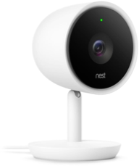
TOO MUCH GIGABITES
Business case
Smarthome secutiy camera recording 24h/24
Data volume = 42Gb/day after H.264 compression
Objective
Reduce bandwith impact
Clean/sample data for cloud
Do not loose any incident data
Alert even without Internet
Result
Reduced to 10Gb/day max
More definition when movement.
SMS alert always available

Slide 22
CHOOSING THE RIGHT SOLUTION

Slide 23
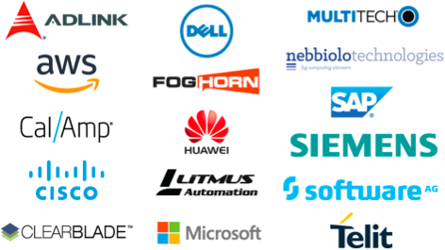

PLENTY OF OPTIONS

Slide 24
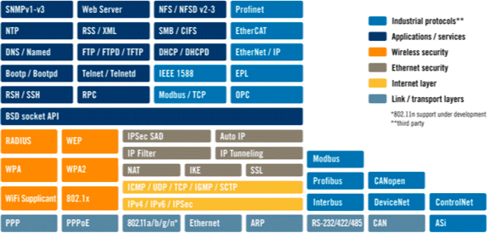
EXTENSIVE PROTOCOL SUPPORT FOR DATA INGESTION

Slide 25
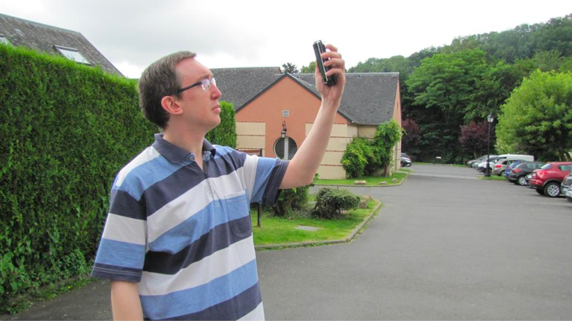
ROBUST CAPABILITY FOR OFFLINE FUNCTIONALITY

Slide 26
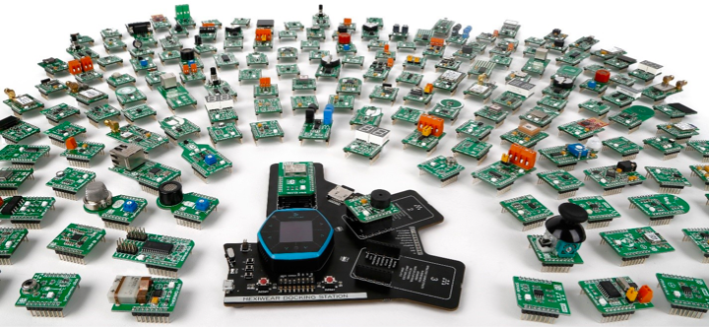
HARDWARE-AGNOSTIC SCALABLE ARCHITECTURE

Slide 27
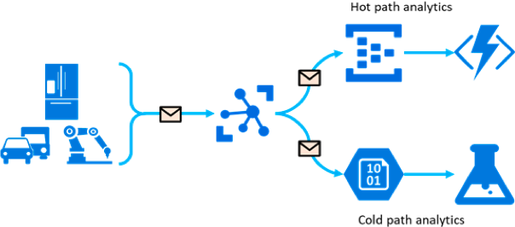
COMPREHENSIVE ANALYTICS AND VISUALIZATION TOOLS

Slide 28

SYNTESIS
EDGE IS AN EVOLUTION OF IOT.
GOOD OPPORTUNITY TO KEEP DATA LOCALLY.
NEED SYSTEM APPRAOCH TO DESIGN THE RIGTH SOLUTION.

Slide 29
Application of Edge Computing in Our Innovation of Healthcare Domain

Slide 30
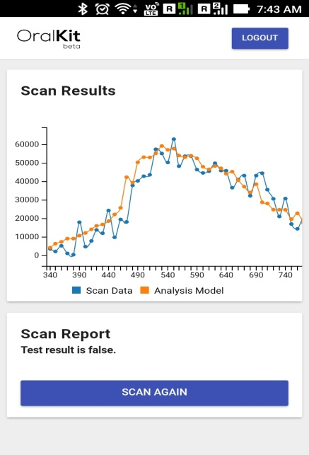
Our Smart Phone based Cancer & DME Solutions

Slide 31
Impact on BOP Level
First Solution
Pain free Early Stage Cancer Diagnosis and Low Cost Portable Device
Second Solution
Generate report in a few minutes where biopsy examination takes several days
Third Solution
Automatic Solutions and Highly Efficient
9

Slide 32
Unique Selling Proposition
Replacing Painful and Cost Effective Biopsy
100 Times Cheaper than Biopsy and
Accuracy >95%
Portable & Lightweight and 80 Times Faster than Biopsy

Slide 33
Business Model
B2B Product for Ophthalmologists
SaaS
Device
Rs100/Scan
One Time Rs20000

Slide 34
Growth Strategiesowth Strategy
Current
Future
Ongoing Clinical Trail
in Hospitals
Doctors Collaboration 50-50 Revenue Sharing Model

Slide 35





Competitive Landscape of Our Innovation Twelit
Low Cost
Accuracy >95%
Smart Device
Data Driven
Cloud Based

Slide 36
Media Reports on Published Research: New technique for early detection of human eye diseases
Televisions: [1]Zee News: http://zeenews.india.com/health/this-new-technique-can-detect-human-eye-diseases-early-1962133 [2]Odisha TV: https://odishatv.in/technology/new-technique-for-early-detection-of-human-eye-diseases-184520/ [3]News World India: https://newsworldindia.in/lifestyle/now-early-detection-of-human-eye-diseases-is-possible-know-how/240282/ [4]NewsX: http://www.newsx.com/health-and-science/50839-new-technique-for-early-detection-of-human-eye-diseases Global News Site: Yahoo News: https://in.news.yahoo.com/technique-early-detection-human-eye-diseases-081403358.html Science Magazine: Nature India: http://www.natureasia.com/en/nindia/article/10.1038/nindia.2016.169

Slide 37
Media Reports on Published Research: New technique for early detection of human eye diseases
Newspapers [1]The Hindu: http://www.thehindu.com/sci-tech/science/Indian-scientists%E2%80%99-novel-approach-to-diagnose-retinal-diseases/article17004895.ece#comments [2]Business Standard: http://www.business-standard.com/article/news-ians/new-technique-for-early-detection-of-human-eye-diseases-116122700377_1.html [3]The Indian Xpress: https://theindianxpress.com/20056/ [4]The Economic Times: http://economictimes.indiatimes.com/news/science/new-technique-for-early-detection-of-human-eye-diseases/articleshow/56198412.cms?from=mdr

Slide 38
24. Cancer Research Success
Newspapers & Research Magazines: [1]The Hindu:http://www.thehindu.com/sci-tech/science/diagnosing-early-stage-cervical-cancer-using-artificial-intelligence/article22267117.ece [2]Business Standard:http://www.business-standard.com/article/news-ians/computer-based-optical-method-detects-early-stage-cervical-cancer-117122800553_1.html [3]The Indian Express: http://indianexpress.com/article/lifestyle/health/computer-based-optical-method-detects-early-stage-cervical-cancer-5002420/ [4]Analytics India Magazine: https://analyticsindiamag.com/ai-cancer-detection-india-light-scatter-algorithm/
[5] Nature India :https://www.natureasia.com/en/nindia/article/10.1038/nindia.2017.148
AI based early stage cancer detection
24

Slide 39
IBPS,Banking,IAS,UPSC Exams Current Affair Syllabus
[1] http://bankexamportal.com/daily-current-affairs/24-december-2017 [2]http://iasexamportal.com/civilservices/daily-current-affairs/24-12-2017

Slide 40
Award On AI Based Early Stage Disease Detection
My futuristic research on ‘AI Based Early Stage Disease Detection’ was nominated among top 10 finalists in Global IMT X-Prize international competition in USA. Dr.Barmak Heshmat, Research Scientist, MIT was one of the organizers of IMT X-Prize global competition. The panel comprised of eminent scientists and artists from MIT, NASA, Marvel Studios (Franchises of block buster Hollywood movies like X-Men, Spider Men). The competition theme was to produce futuristic ideas for 'AI (Artificial Intelligence) for Good'. I was among top 10 finalists but ended as a runner up.
25

Slide 41




@SM2017Official
Join me:
@sabyasachi_mukhopadhyay
https://www.linkedin.com/in/sabyasachi-mukhopadhyay-303a1027/
@sabyasachi_unique

Slide 42
THANK YOU
For your time & we’ll see you soon

